Slide 1
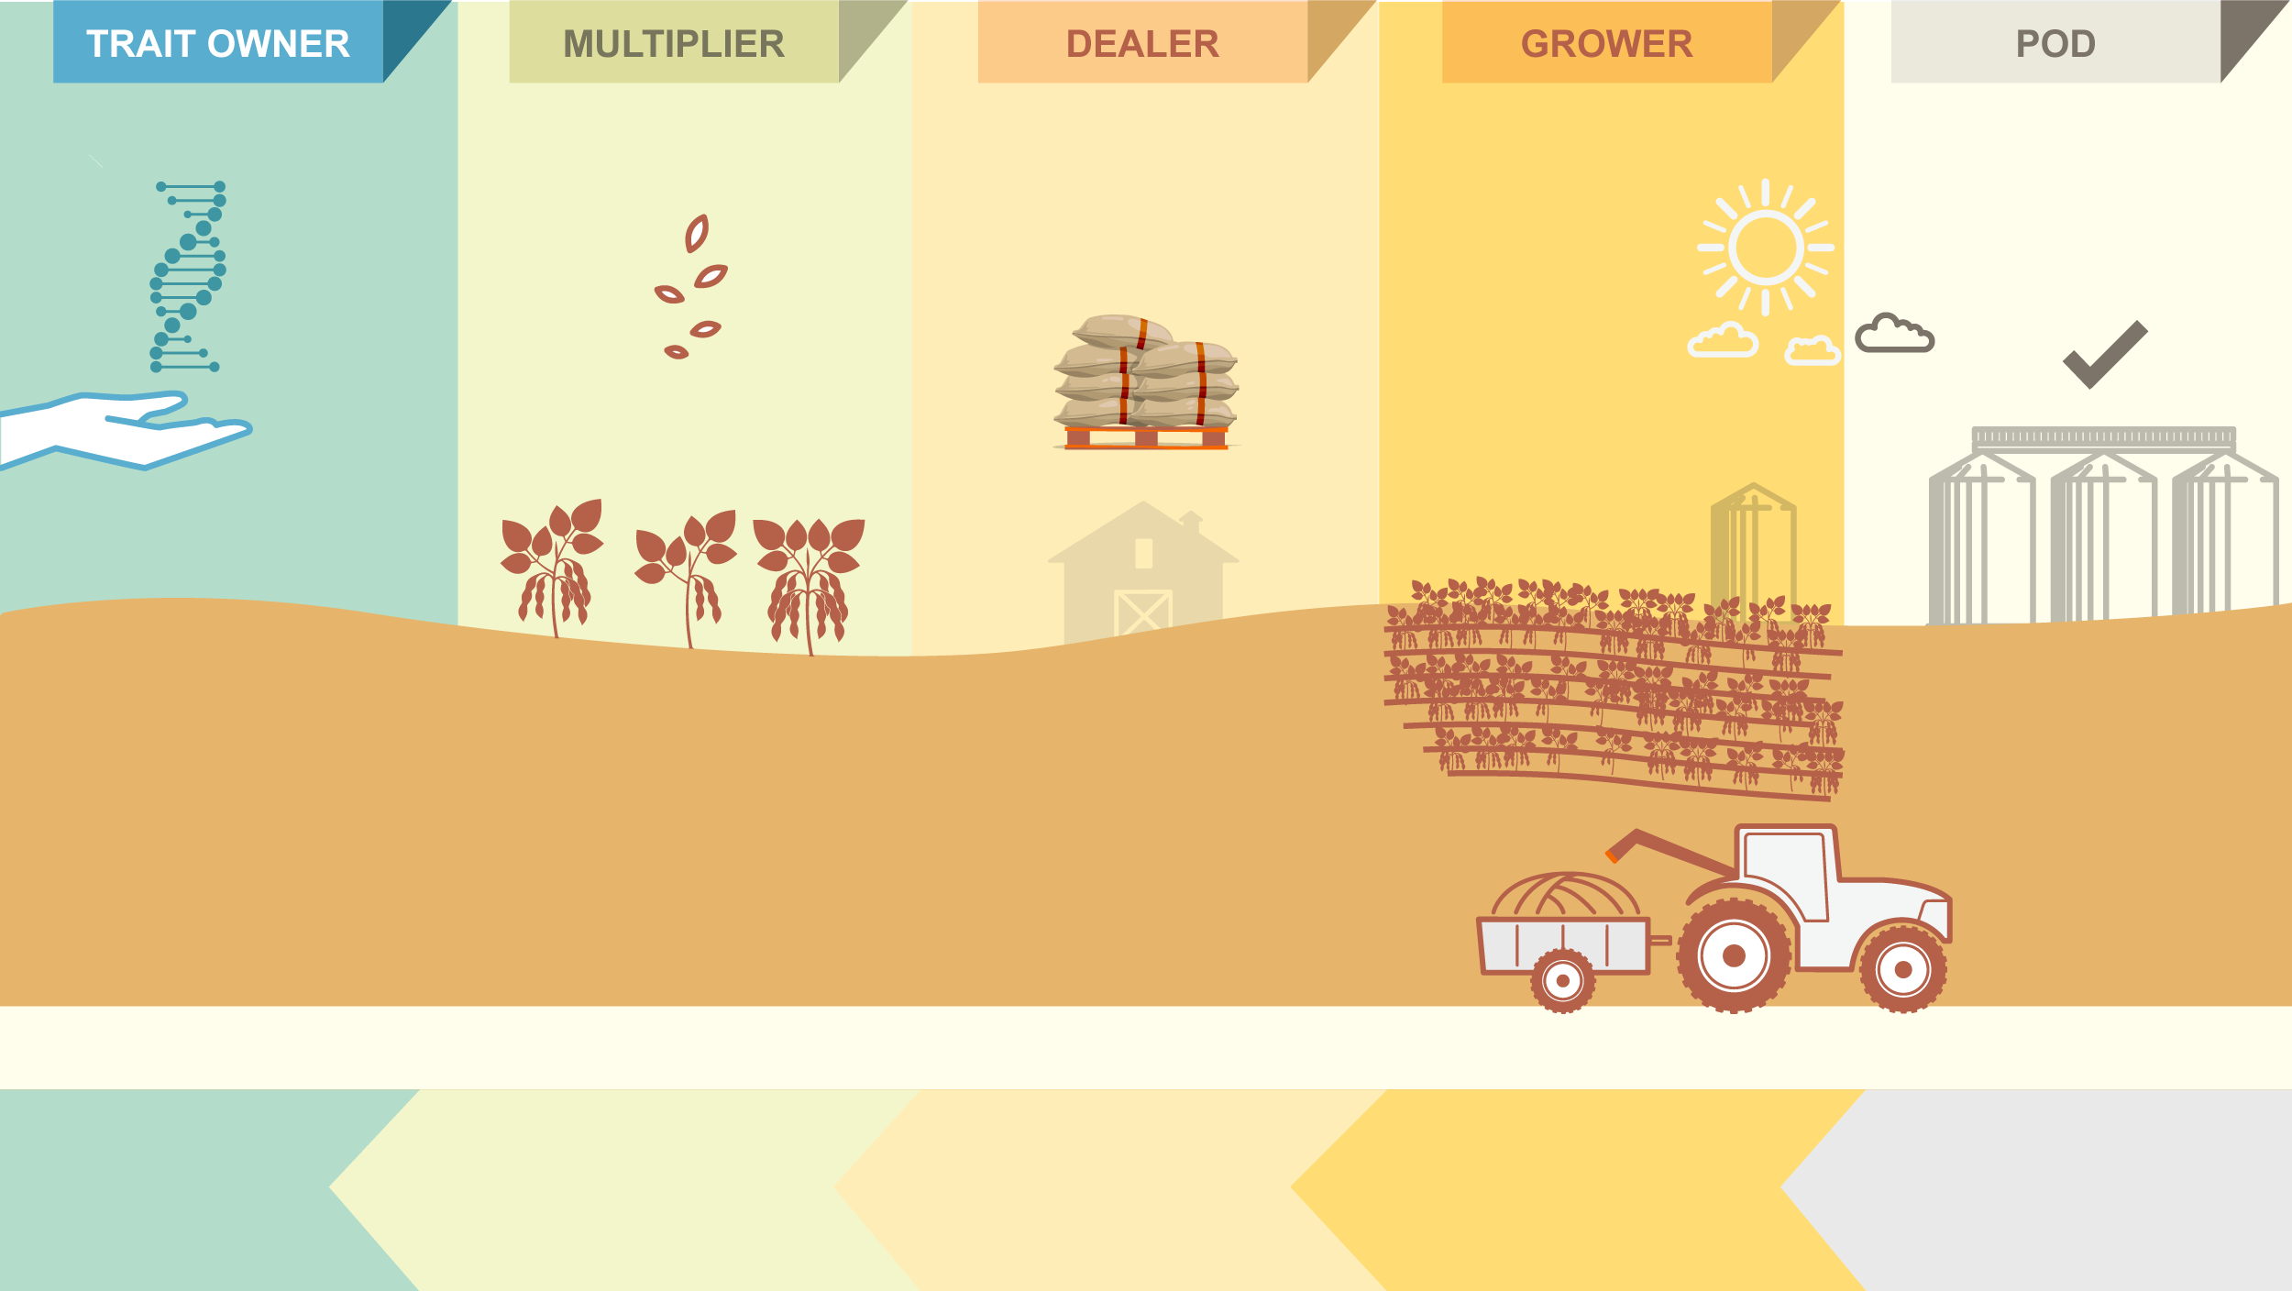

VALUE
Trait R&D
Seed Production
Seed Sales
Grain Production
Grain Receiving
Certified
Seeds
Saved Seeds
Trait
License
Certified
Seeds
The system enables Trait Owners* to collect revenue related to intellectual property rights in countries where growers are allowed to save seeds.
Grains
CAPTURE
* Currently only Bayer, but the vision is to become an Industry System (serving other Trait Owners).
Value Capture System Core Modules
Revenue over Multiplication
Revenue over Seed Sales
Revenue over
Legally Saved Seeds
Revenue over POD
(Illegally Saved Seeds)

